Slide 1
Measuring the Piezoelectric Coefficients of Thin Films
Joe T. Evans, Jr.
Radiant Technologies, Inc.
October 30, 2019

Slide 2
Summary
Radiant Technologies offers two tools that together enable the characterization and control of piezoelectric films during product development and manufacturing.
Laser interferometry to measure d₃₃ and evaluate piezoMEMS motions.
e₃₁ characterization to track film piezoelectric coefficients.

Slide 3
Introduction
  Definition of piezoelectric coefficients, what can be measured, and what cannot.
  Measuring d₃₃ of thin piezoelectric films
  Measuring e₃₁ of thin piezoelectric films
  Recommended procedures for control of piezoelectric properties in process.

Slide 4
Piezo Coefficients
There are four practical piezoelectric coefficients:
d₃₃ Vertical displacement of the film surface when a voltage is applied between parallel electrodes.
d₃₁ The sideways contraction of the film as it expands vertically during d₃₃ activation
e₃₃ The vertical force applied by the top surface of the film when it is displaced during d₃₃ activation.
e₃₁ The sideways force applied by the film when it is displaced during d₃₃ activation.

Slide 5
Piezo Coefficients
Only two of the four piezoelectric coefficients can be measured on a thin film:
d₃₃ This is a small value that requires a laser for resolution.
d₃₁ It is not possible to see this motion with a sensor.
e₃₃ It is may be possible to measure vertical force with an AFM but it is difficult to make it accurate.
e₃₁ The lateral force generated by the film will bend a cantilever, the motion of which can be seen by a laser or a photonic sensor.

Slide 6
Physical Limitations
The physical dimensions of the device under test sets limitations on what sensor must be used.
Photonic sensors generally have minimum spot diameters of 0.3mm to 3mm.
  Only large flat structures can be measured with a photonic sensor.
  Photonic sensors are inexpensive.
The moving structures in piezoMEMS are generally too small to be seen by a photonic sensor.
  Lasers can have spot sizes down to 2 microns so they can spatially resolve small areas of the sample.
  Laser are more expensive than photonic sensors.

Slide 7
Metrology Tools
Photonic sensors are suitable for measuring precise, large-area-averaged film coefficients.
Laser Doppler Vibrometers with their small spot sizes are suited for measuring production pMEMS devices in situ.
The two work well together:
  The photonic sensor measures the film’s global e₃₁ coefficient on process monitor wafers run alongside wafer lots.
  The film d₃₃ coefficient is measured directly from clamped capacitors on the monitor wafer using a laser.
  The performance of the devices in fabrication are predicted using the measured e₃₁ and e₃₁ values.
  The laser directly measures the motions of the piezoMEMS. Deviations from the model values indicate process issues.

Slide 8
Introduction to Laser Interferometry

Slide 9
The NLV
Radiant has extensively tested Polytec’s NLV Laser Doppler Vibrometer coupled to a Radiant Materials Analyzer.
The Precision LC II, Premier II, Precision Multiferroic, and piezoMEMS testers use 18-bit ADCs, have a 76 microvolt per bit resolution, and exhibit a noise floor of ~300µV for a single pass.
  The single-bit ADC resolution can be reached by averaging x16.
Combined with the NLV, these testers can reach 0.2 Ångstrom (0.02nm) resolution in d₃₃ piston motion.
The NLV has a 2 micron minimum spot diameter.

Slide 10
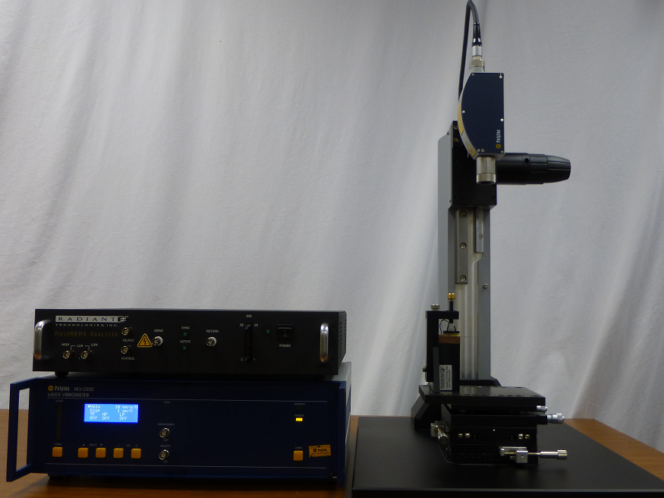
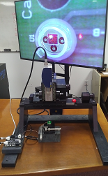
The NLV Tower
Tester
Sensor 2
Sensor 1
Polarization
Stimulus
NLV
Video
The camera embedded inside the NLV laser head is essential for aligning the laser spot to the intended area on tiny samples.
Velocity
Displacement

Slide 11
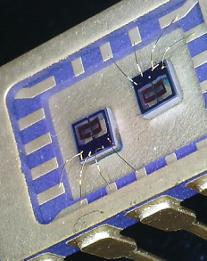
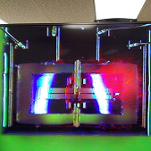
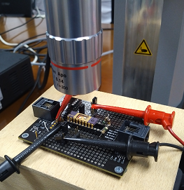
piezoMEMS Measurement
The NLV measuring a 460 micron wide by 580 micron long cantilever.
LDV laser

Slide 12

Binary Wings
1 Hertz switching hysteresis loop of the parallel plate capacitors
Approximately ±6μm tip displacement.

Slide 13
Butterfly Motion
Parallel-Plate Actuator
Cantilever tip double butterfly loop driven by perimeter parallel-plate capacitors at 1Hz/20V with 32,000 points.

Slide 14
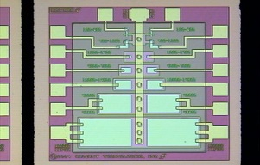
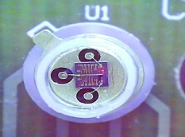
d₃₃ with NLV
The NLV can see piston motion of clamped thin films.
Silicon substrate thickness under capacitor = 550 microns.

Slide 15
Introduction to E31

Slide 16
Why e₃₁?
In 1909, George Stoney derived an equation describing how a thick cantilever bends when a change in temperature causes contraction of a thin film on one surface of the cantilever.
Instead, substitute a piezoelectric film to bend the beam using voltage:
Cantilever = mechanical amplifier: The lateral stress produced by that voltage due to e₃₁ moves the cantilever tip vertically much further than the tiny strain of the top surface of the piezoelectric film due to d₃₃.
.
0V
Vcap
  Larger Displacement =
  Cheaper Displacement Sensor =
  Inexpensive Instrument!

Slide 17
Why e₃₁ ?
The desired piezoelectric coefficients for characterizing materials are d₃₃ and d₃₁.
For the piezoelectric material to change its dimension, it must apply a force against itself in order to shrink or expand.
Young’s Modulus relates the Stress necessary to create the associated Strain in any material.

Slide 18
Why a Cantilever ?
In the e₃₁ measurement, the thin-piezoelectric-film capacitor is placed on the top surface of a passive cantilever.
The strain produced by that piezoelectric capacitor bends the cantilever, causing the cantilever tip to move vertically far more distance than does the surface of the piezoelectric film.
  The cantilever is a mechanical amplifier in the e₃₁ measurement!

Slide 19
The Mazzalai Equation
Radiant uses the Mazzalai Equation to calculate the e₃₁ coefficient that produced the measured cantilever tip displacement at voltage V.
  v = Poisson’s ratio for the substrate
  x₁ = Distance from clamp point to the end of the piezoelectric capacitor
  x₂ = Distance from clamp point to the displacement sensor.
  z = Cantilever tip displacement with application of V.
  The equation states that e₃₁ can be calculated for any cantilever of any geometry.
$${ e}_{31}=−\frac{1}{3} \left[\frac{Y_{Cant} {\left(t_{Cant}\right)}^{2}}{\left(1−v\right) \left[x_{1}\left(2x_{2}−x_{1}\right)\right]}\right] \left(\frac{Cantilever Width}{Capacitor Width}\right) \frac{z\left(at x_{2}\right)}{V}$$
.
[Mazzalai, Balma, Chidambaram, Jin, & Muralt, International Symposium on Applications of Ferroelectrics – ISAF/PFM, Prague, Czech Republic; 07/2013]

Slide 20

Geometry of Fixture and Sensor
Drive
Return
Earth Ground
No Capacitance
Cantilever
Clamped
Free

Slide 21
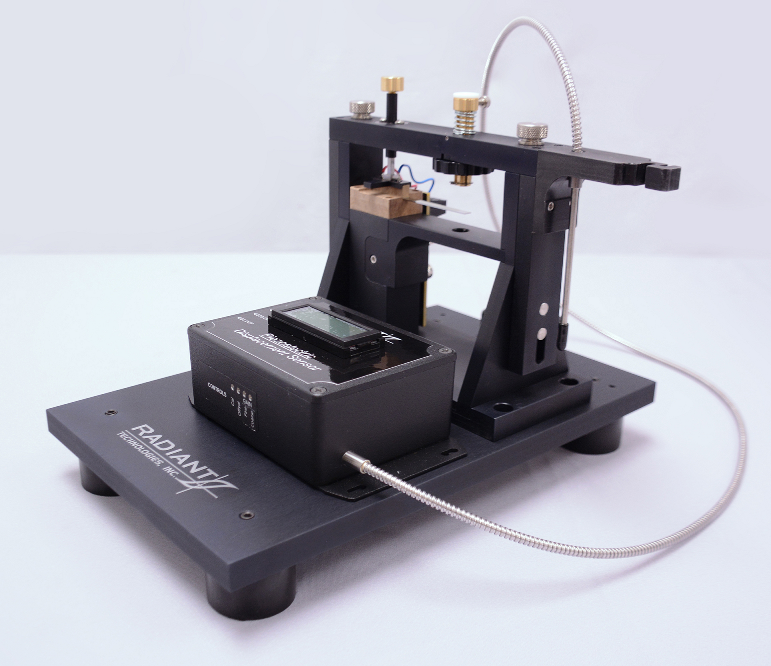
E₃₁ Fixture with Cantilever

Slide 22
Equation Definitions
The definitions of the parameters in the Mazzalai equation:
  v = Poisson’s ratio for the cantilever material
  Y = Young’s Modulus for the cantilever material
  t_{Cant} = Cantilever Thickness
x₂
.
t
x₁
w

Slide 23
Cantilever Geometry
100mm silicon wafer substrate [4” wafer]
72mm
Contact #2
19.05mm
6.35mm
Contact #1
41.96mm
25.4mm
Sensor Point
Clamp
Foot

Slide 24
Radiant Cantilever Process
72mm
TE Contact
19.05mm
6.35mm
BE Contact
41.96mm
25.4mm
Sensor Point
Clamp
Foot
BE
FE
TE
FE
Etch
Parasitic capacitance is reduced by a hole in the bottom electrode.

Slide 25
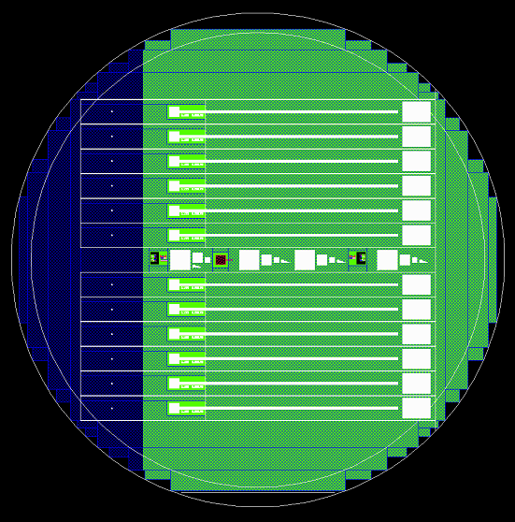
Cantilever Wafer Mask
Each wafer is diced or sawed to the proper widths & lengths to release the cantilevers.

Slide 26
Classic Curve
Polarization & tip displacement are captured in parallel.
δ = kVd₃₁
Since δ = kVd₃₁, the butterfly loop has the same shape as the film piezoelectric response but scaled up by the cantilever’s mechanical amplification factor k.

Slide 27
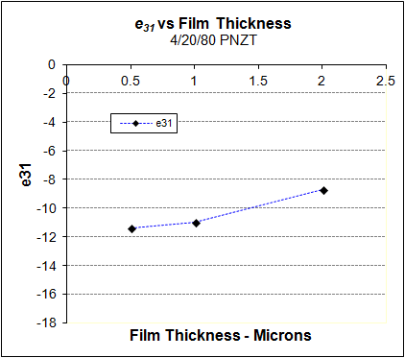
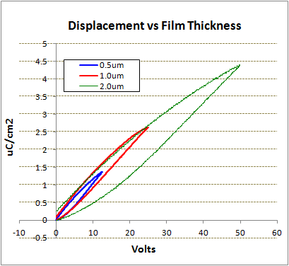
e₃₁ vs Thickness
E₃₁ goes down as the voltage increases because of the paraelectric effect on polarization.

Slide 28
Displacement vs Voltage
0.5μm 52/48 in 0.25V steps

Slide 29
Composition Comparison
52/48 PZT = 20.8 C/m²
4/20/80 PLZT = 16.1 C/m²
4/20/80 PNZT = 12.5 C/m²
Three compositions with identical cantilever and capacitor geometries.

Slide 30
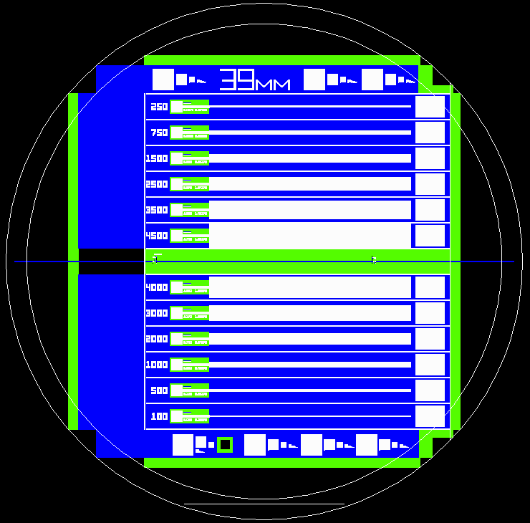
Example Test
PROPOSAL:
Build a series of e₃₁ cantilevers on the same wafer having a range of actuator capacitor widths for a fixed cantilever width.
Measure and compare e₃₁ coefficients for all cantilevers.

Slide 31
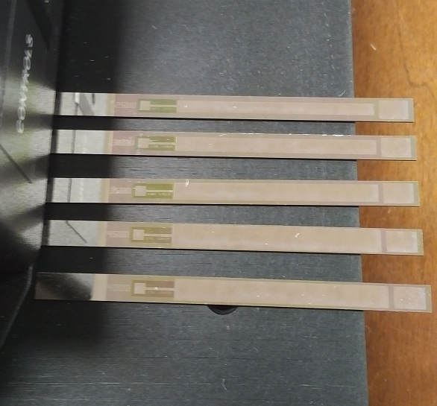
Samples
Five of the 12 cantilevers are shown starting with the 4500µm width at the bottom of the image.
The top electrode widths varied from 4500µm down to 100µm in 12 steps. Otherwise the cantilevers are identical.
2µm-thick 52/48 PZT

Slide 32
Test Procedure
  The following tests were executed in the same order on each cantilever from within a Vision Test Definition to ensure identical histories.
  Virgin 40V bipolar hysteresis. (Each cantilever was untouched at the start.)
  40V Remanent Hysteresis Task.
  40V monopolar hysteresis w/ switching & non-switching half loops.
  40V monopolar hysteresis with only non-switching half loops.
  Single 5V monopolar hysteresis.
  5V monopolar hysteresis averaged 16 times.
  Other loops using ratio’d voltages or constant displacement conditions.
  The averaged 5V monopolar actuator displacements were used to calculate e₃₁. The 5V amplitude was selected so that the widest cantilever would produce a displacement within the best sensitivity range of the photonic sensor. The narrowest electrodes required averaging.
.

Slide 33
Sample Response

Slide 34
5V Results
Systematic variation in e₃₁ due to variance vertically top-to-bottom across wafer vs position of each cantilever on the wafer.
.
No effect of TE Width on e₃₁ is apparent in the data!

Slide 35
40V Results
.
Again, no effect of TE Width on e₃₁ is apparent at 40V.

Slide 36
E31 Advantage
  There is an advantage to measuring e₃₁ using large area cantilevers having the full thickness of the silicon substrate.
  Cantilevers diced from a wafer have the full thickness of the silicon substrate. There can be no manufacturing defects in the cantilever that distort e₃₁ performance.
  The area of the actuator capacitor atop the cantilever is very large so the e₃₁ coefficient derived from the measurements will be the average for the film.
  Large, full thickness cantilever e₃₁ measurements see only the film properties, not manufacturing variances.

Slide 37
Recommended Procedure
  Fabricate 3 masks for e₃₁ cantilevers and small-area d₃₃ capacitors on their own tracking wafer. Place small cantilevers on product wafers.
  Run tracking wafer alongside product wafers on a regular basis.
  Measure the e₃₁ of the large-area tracking E31 cantilevers and use NLV to measure d₃₃ of the small-area tracking capacitors.
  Insert measured values into simulation models of the product devices to predict product performance.
  Measure small test cantilevers on product wafers with the NLV. Calculate on-wafer e₃₁/d₃₃ values. Compare to tracking values.
  Sample product performance across wafers and compare to the performance predicted by the model simulated with tracking coefficients. Variances should indicate process non-uniformities.

Slide 38
Conclusion
  Radiant’s E31 fixture inexpensively characterizes the e₃₁ coefficient of thin ferroelectric and piezoelectric films.
  The Polytec NLV connected to Radian’s Precision Materials Analyzers is able to measure d₃₃ coefficients of clamped thin piezoelectric or ferroelectric films to less than 1 Ångstrom.
  The small NLV’s spot size and large dynamic range allows it to directly measure the motions of structural members in a piezoMEMS.
  Used in combination, the Radiant E31 Fixture and the NLV provide a sensitive process monitoring and control metrology tool set.

